Slide 1






EZ – swap
Battery Swapping System
GUIDE
MEMBERS
Nidhi Sawant
Justin Madhri
Sagar Shah
Dr. Prachi Raut

Slide 2
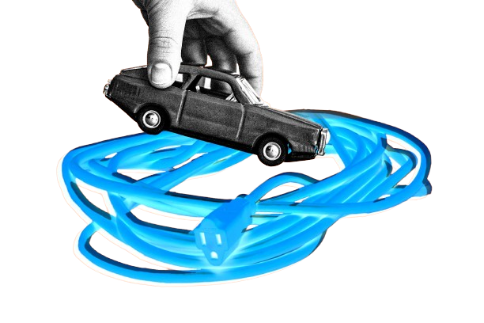
Battery Swapping Systems ?
Revenue model
?
Fundings?
Problem in existing
EVs chargers ?
EZ-swap solves?
Products/
services?
Direct/Indirect competitors?
EV and BSS market?
Traction
Unique Selling Point?

Slide 3

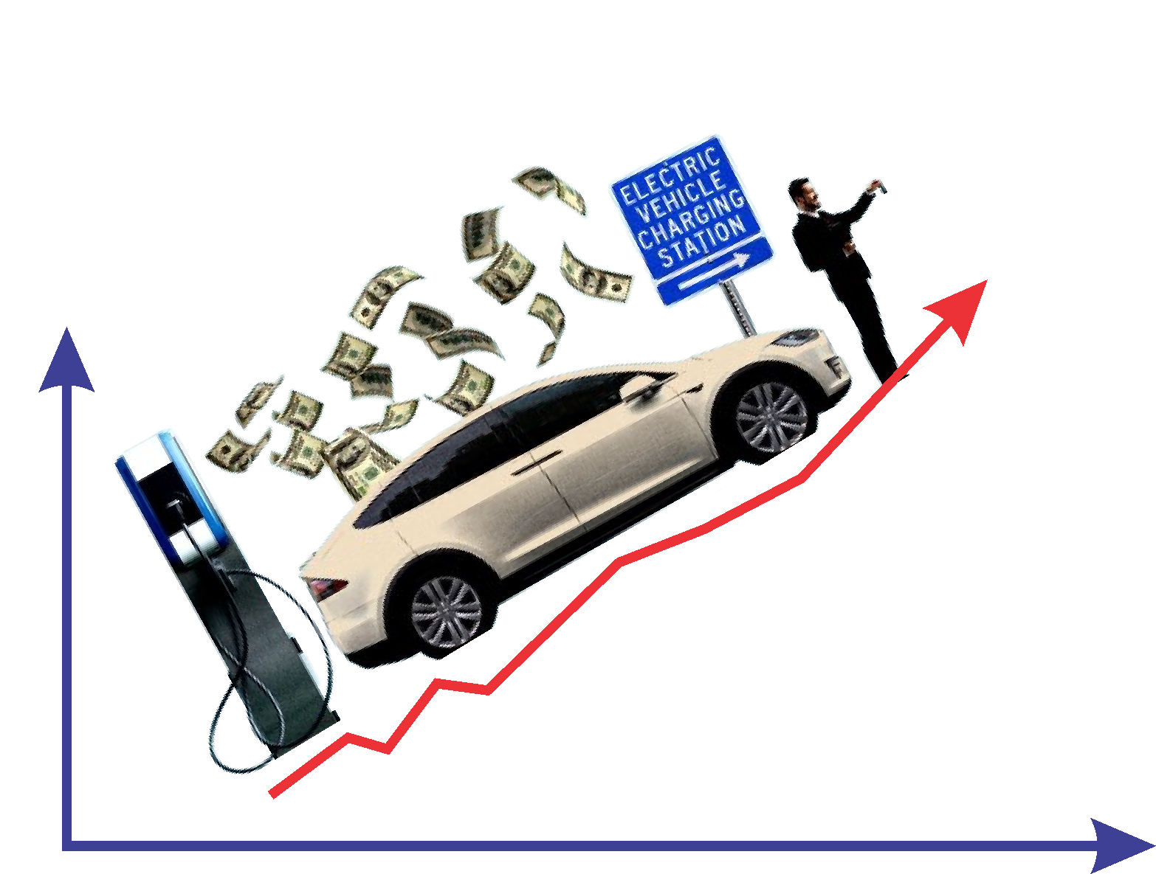
EVs
are FUTURE ?

Slide 4

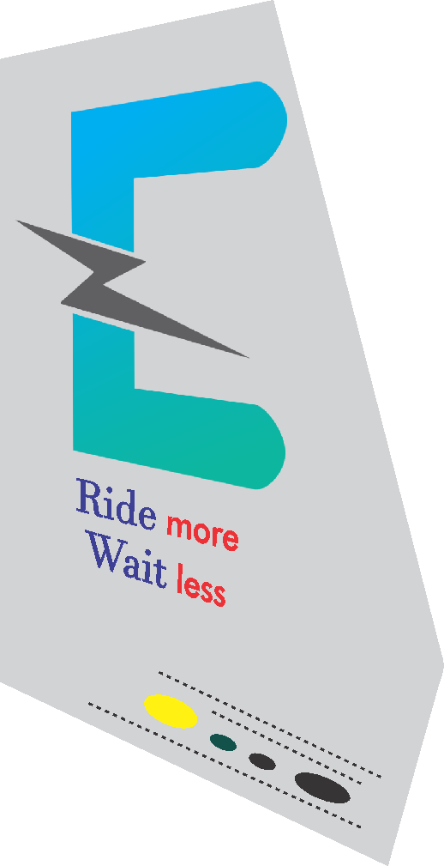


Charging Time More
Ride Time Less

Slide 5
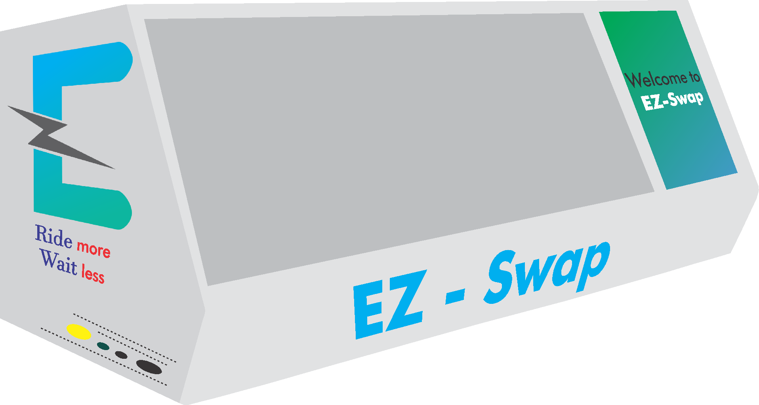
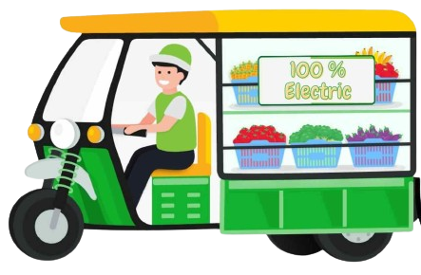
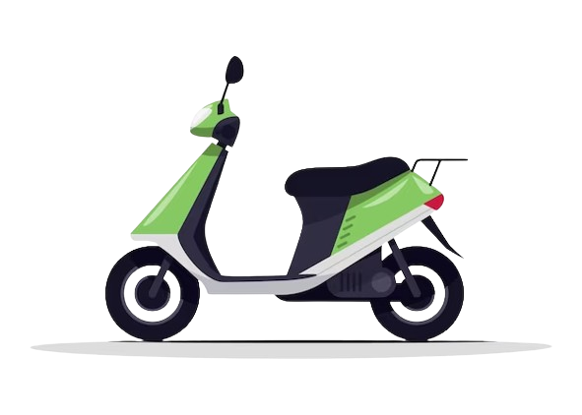


Marketing
Campaigns
Ride More
Wait Less
Awareness
Tie-ups

Slide 6

Implementation
In an area
Marketing
Campaigns
Awareness
Prototype
Tie-ups
Testing

Slide 7


The AIM
Is clear!

Slide 8


2W EV in India Today ~5%
2W EV in India By 2030 ~45%
200+ EVs Per Commercial Charging Point in India
SAM (Serviceable Available Market)
Battery Swappable EVs
Rs. 82,84,47,500 today
SOM (Serviceable Obtainable Market)
EZ – Swap can scale up and can obtain
15-20% of SAM
i.e. Rs. 12,50,00,000 – 17,00,00,000

Slide 9

Scalability in Metropolitan Cities
Marketing
Campaign Awareness
So HOW we will tackle them?

Slide 10
Scalability in Metropolitan Cities
Marketing
Campaign Awareness
So HOW we will tackle them?

Slide 11

So HOW we will tackle them?
Strategic Marketing
Area wise Targeting
Collaboration with EV Manufacturers
Awareness Campaign about EVs
Tie-Ups with other Vendors

Slide 12
Expenditures
Cost of one EZ-Swap station initially is
₹3,17,500
Cost of 20 EZ-Swap stations initially in
Borivali-Kandivali-Andheri would be
₹6350000

Slide 13
The cost of Infrastructure and
Batteries are one-time investment Hence the monthly cost would only
₹1,72,500
Expenditures
Cost of one EZ-Swap station initially is
₹2,11,250
Cost of 20 EZ-Swap stations initially in
Borivali-Kandivali-Andheri would be
₹42,25,000

Slide 14
Expenditures
The cost of Infrastructure and
Batteries are one-time investment Hence the monthly cost would only
₹66,250
Cost of one EZ-Swap station initially is
₹3,17,500
Cost of 20 EZ-Swap stations initially in
Borivali-Kandivali-Andheri would be
₹6350000

Slide 15
Revenue Model
An individual will charge their EV from 10% charge to 100% charge
Revenue per month is ₹ 2,70,000 which is more than
monthly expenditures (excluding infrastructure cost and batteries costs)
Per percent (%) cost is ₹0.5
An EV needs to fully charged atleast once in a day
90% charged x ₹0.5 = ₹45 cost to swap one battery a day
₹45 x 30 days (1 Month) = ₹1350 per month from one user
Goal = on an average 100 users swapping batteries each day at each station
Achievable if done correct marketing, and target markets strategically
Hence, for 100 users at each station, Revenue per month=
₹1,35,000

Slide 16
Revenue Model
Revenue per month is ₹ 2,70,000 which is more than
monthly expenditures (excluding infrastructure cost and batteries costs)
An individual will charge their EV from 10% charge to 100% charge
Per percent (%) cost is ₹1
An EV needs to fully charged atleast once in a day
90% charged x ₹1 = ₹90 cost to swap one battery a day
Gross profit(per month) = Revenue – COGS
= 1,35,000 - 66,250
= ₹ 68,750
Gross Profit Margin
=(Revenue – COGS – Operational expense - Taxes)/ Revenue
= 20%
₹90 x 30 days (1 Month) = ₹2700 per month from one user
Goal = on an average 100 users swapping batteries each day at each station
Achievable if done correct marketing, and target markets strategically
Hence, for 100 users at each station, Revenue per month=
₹2,70,000

Slide 17
How are We DIFFERENT?
Parameters | Sun Mobility | Volt Up | EZ - Swap
24/7 Data recording | No | No | Yes
Technicians Available at all time | Yes | No | Yes
Tie Up with other brands | Yes | No | Yes
Cost of Installation | High | High | Low
Cost of Swap | Mid | Mid | Low
Market Targeted | Mid | Small | Large

Slide 18

Fundings
At current stage, EZ – Swap is Bootstrapped and in prototype testing phase
For future fundings, EZ – Swap will collaborate with different educational institution, EV manufacturers and Raise funds from the market
Ride
more
Wait
less

Slide 19

Ride More
Wait Less

Slide 20

Ride More
Wait Less

Slide 21

Ride More
Wait Less

Slide 22
EZ – swap
Ride More
Wait Less

